Slide 1
UNIT 2
Logic Gates and Logic Families

Slide 2
LOGIC GATES
A logic gate is an elementary building block of a digital circuit.
Most logic gates have two inputs and one output.
At any given moment, every terminal is in one of the two binary conditions low (0) or high (1), represented by different voltage levels.
There are seven logic gates:
AND
OR
NOT
XOR
NAND
NOR and XNOR.

Slide 3
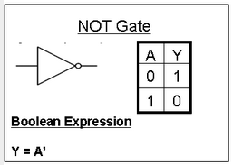
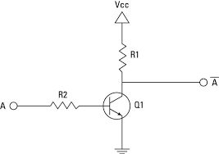
A logical inverter , sometimes called a NOT gate to differentiate it from other types of electronic inverter devices, has only one input. It reverses the logic state.

Slide 4
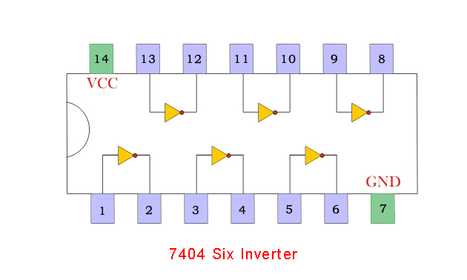

Slide 5
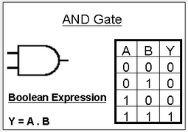
A Logic AND Gate is a type of digital logic gate that has an output which is normally at logic level “0” and only goes “HIGH” to a logic level “1” when ALL of its inputs are at logic level “1”.

Slide 6
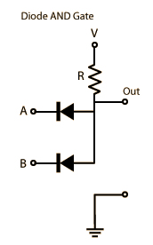
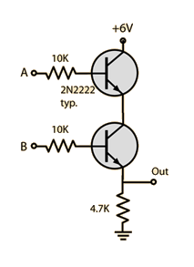
Transistor circuit for AND gate

Slide 7
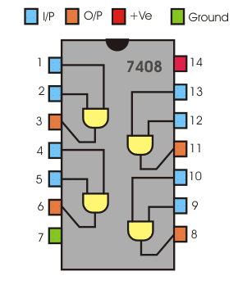

Slide 8
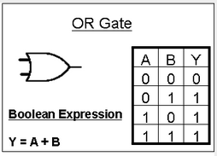
A Logic OR Gate is a type of digital logic gate that has an output which is normally at logic level “0” and only goes “HIGH” to a logic level “1” when one or more of its inputs are at logic level “1”

Slide 9
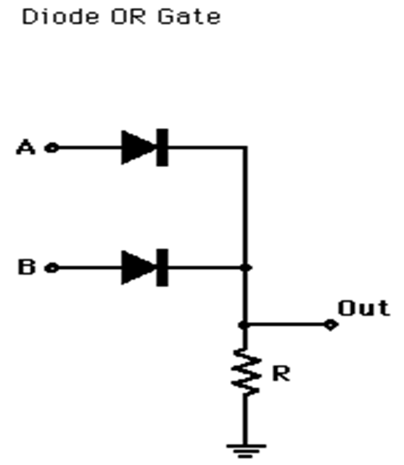
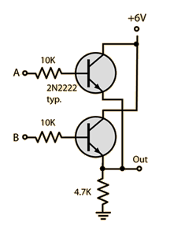
Transistor circuit for OR gate

Slide 10
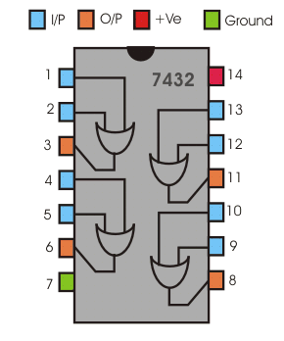

Slide 11
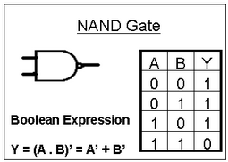
The Logic NAND Gate is a combination of the digital logic AND gate with that of an inverter or NOT gate connected together in series. The NAND (Not – AND) gate has an output that is normally at logic level “1” and only goes “LOW” to logic level “0” when ALL of its inputs are at logic level “1”

Slide 12
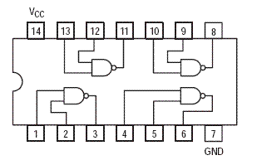

Slide 13
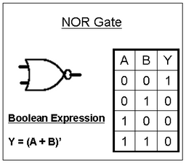
The Logic NOR Gate is a combination of the digital logic OR gate with that of an inverter or NOT gate connected together in series. The NOR (Not – OR) gate has an output that is normally at logic level “1” and only goes “LOW” to logic level “0” when ANY of its inputs are at logic level “1”

Slide 14
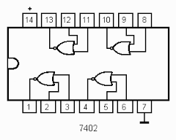

Slide 15
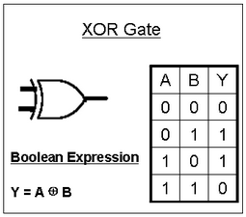
X-OR Gate
The output of an Exclusive-OR gate ONLY goes “HIGH” when both of its two input terminals are at “DIFFERENT” logic levels with respect to each other.

Slide 16
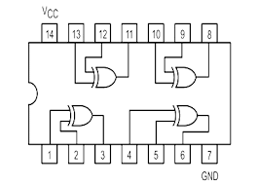

Slide 17
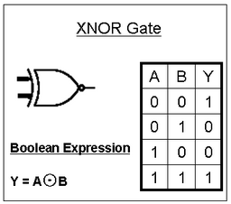
XNOR Gate
“Exclusive-NOR Gate” is a combination of the Exclusive-OR gate and the NOT gate

Slide 18
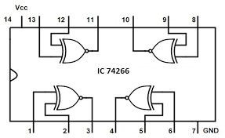

Slide 19
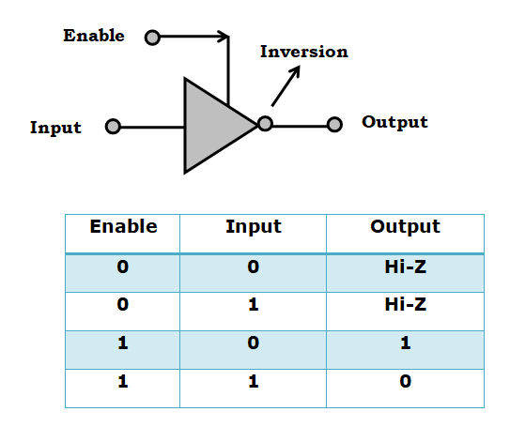
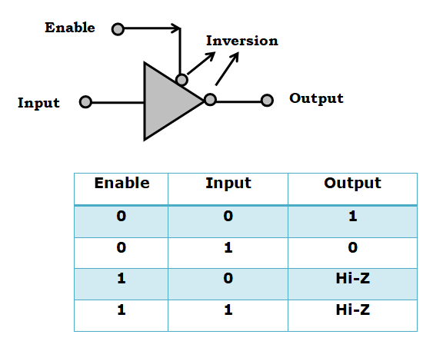
Tristate Logic
Tristate gate is a logic inverter, which has a tristate output. This digital circuit can be electronically connected or disconnected from the output circuit.
Active ‘HIGH’ tristate inverting gate:
Active ‘LOW’ tristate inverting gate:

Slide 20
Boolean Algebra Theorems and Laws

Slide 21
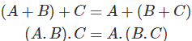
1. Commutative Law
A+B = B+A
2. Associative Law
3. Distributive Law
This law is composed of two operators, AND and OR.

Slide 22
5. AND Laws
A . 0 = 0 where A can be either 0 or 1.
A . 1 = A where A can be either 0 or 1.
A . A = A where A can be either 0 or 1.
A . Ā = 0 where A can be either 0 or 1.
6. OR Laws
A + 0 = A where A can be either 0 or 1.
A + 1 = 1 where A can be either 0 or 1.
A + Ā = 1
A + A = A
7. Inversion Law
A = A

Slide 23
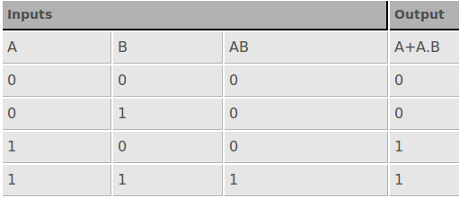
8. Absorption Law

Slide 24
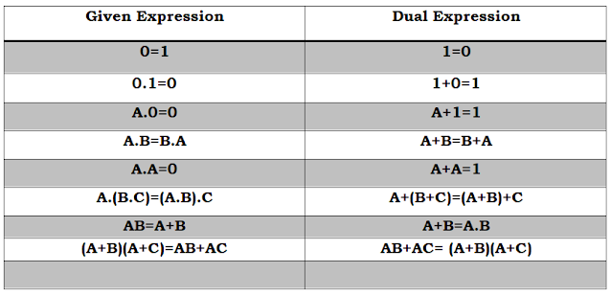
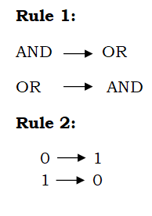
Duality Theorem
According to the principle of duality one type of operation can be changed into another type of operation just by interchanging 0 and 1.
For example the AND and OR operation can be interchanged by changing the values 0 and 1. This principle is used to reduce the Boolean expressions.

Slide 25
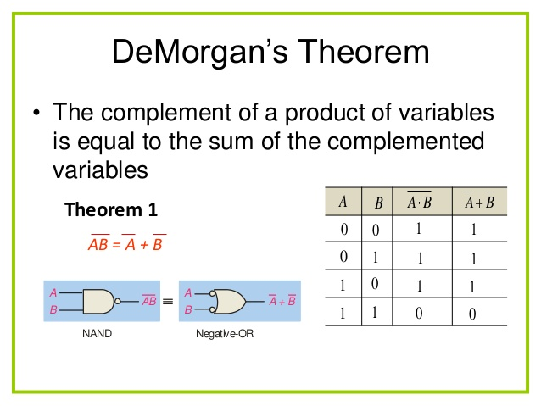

Slide 26
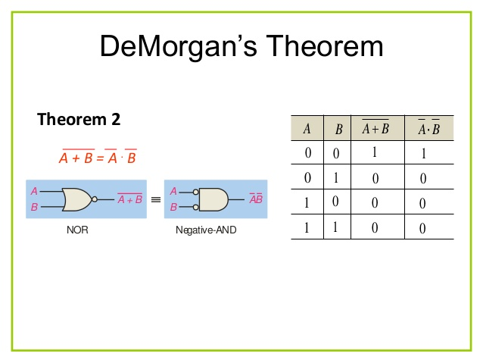

Slide 27
Implementation Using NAND Gate

Slide 28
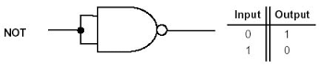
NOT Gate Using NAND Gate
When, both inputs of a two inputs NAND gate are zero, the output is 1
and both inputs of the NAND gate are 1, the output is 0.
Hence a NOT gate can very easily be realized from NAND gate just by applying common inputs to the NAND gate. This is done by short circuiting all the inputs terminals of a NAND gate.

Slide 29
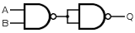
AND Gate Using NAND Gate
A NOT gate followed by a NAND gate realizes an AND gate. In this case we use the NOT gate which is realized from NAND gate and the logic circuit is shown below,

Slide 30
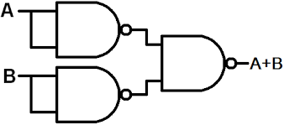
OR Gate from NAND Gate

Slide 31
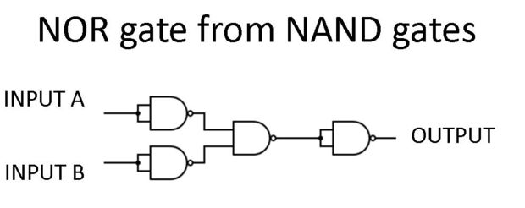

Slide 32
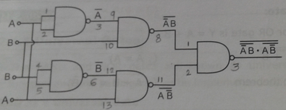
X-OR using NAND Gate

Slide 33
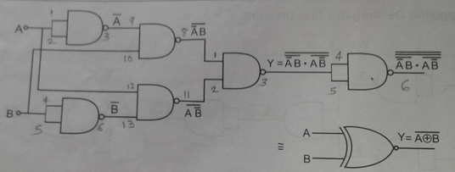
X-NOR using NAND Gate

Slide 34
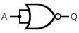
NOT Gate Using NOR Gate

Slide 35
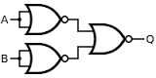
AND Gate Using NOR Gate

Slide 36
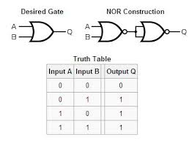
OR Gate using NOR Gate

Slide 37
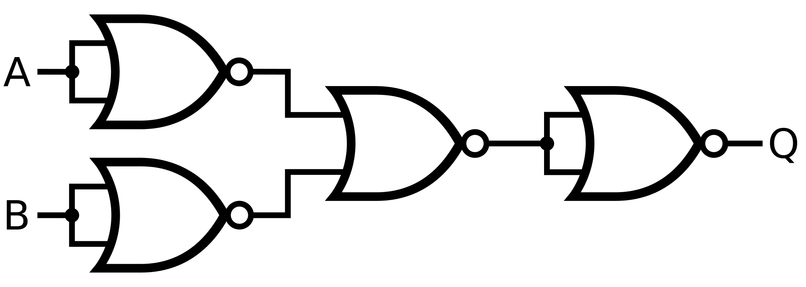
NAND Gate using NOR Gate

Slide 38
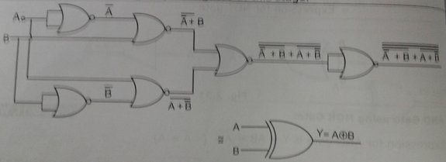
X-OR using NOR Gate

Slide 39
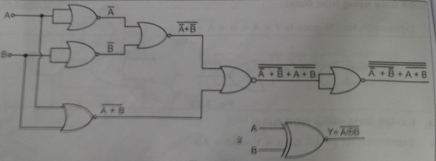
X-NOR using NOR Gate

Slide 40
Reduction of Logic expression using Boolean Algebra
Simplify thr following expressions with boolean laws:
1. Y = AB + AB + AC + AC
2. Y = ABC ( ABC + ABC + ABC )
3. Y = A ( A+C )( A B +C )

Slide 41
Circuit Realization
1. Draw the logical circuit for Y = AB + AB
2. Draw the logical circuit for Y = A + BC + AB
3. Draw the logical circuit for Y = ABC + AB + AC

Slide 42
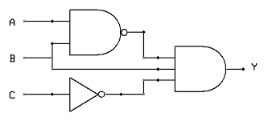
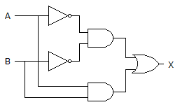
Write logic equation for following circuit

Slide 43


Slide 44
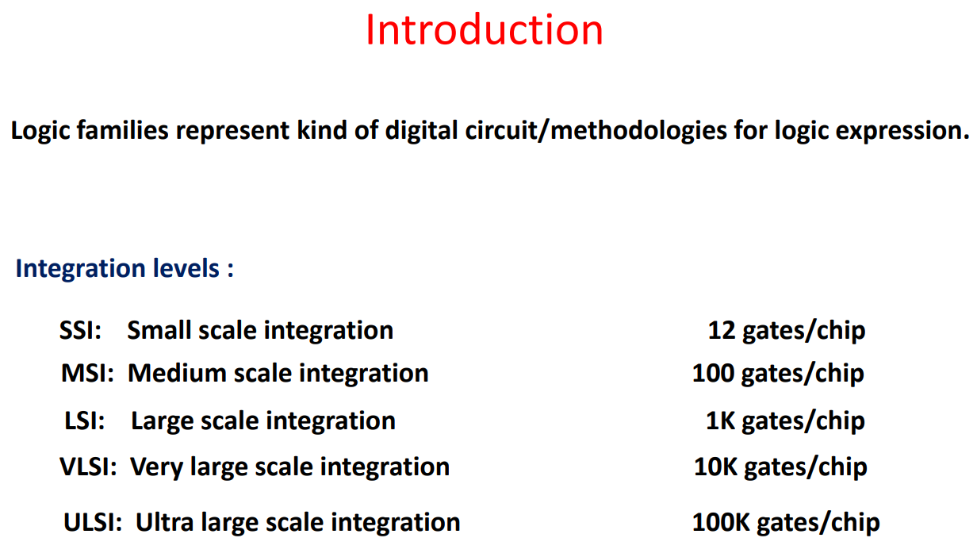

Slide 45
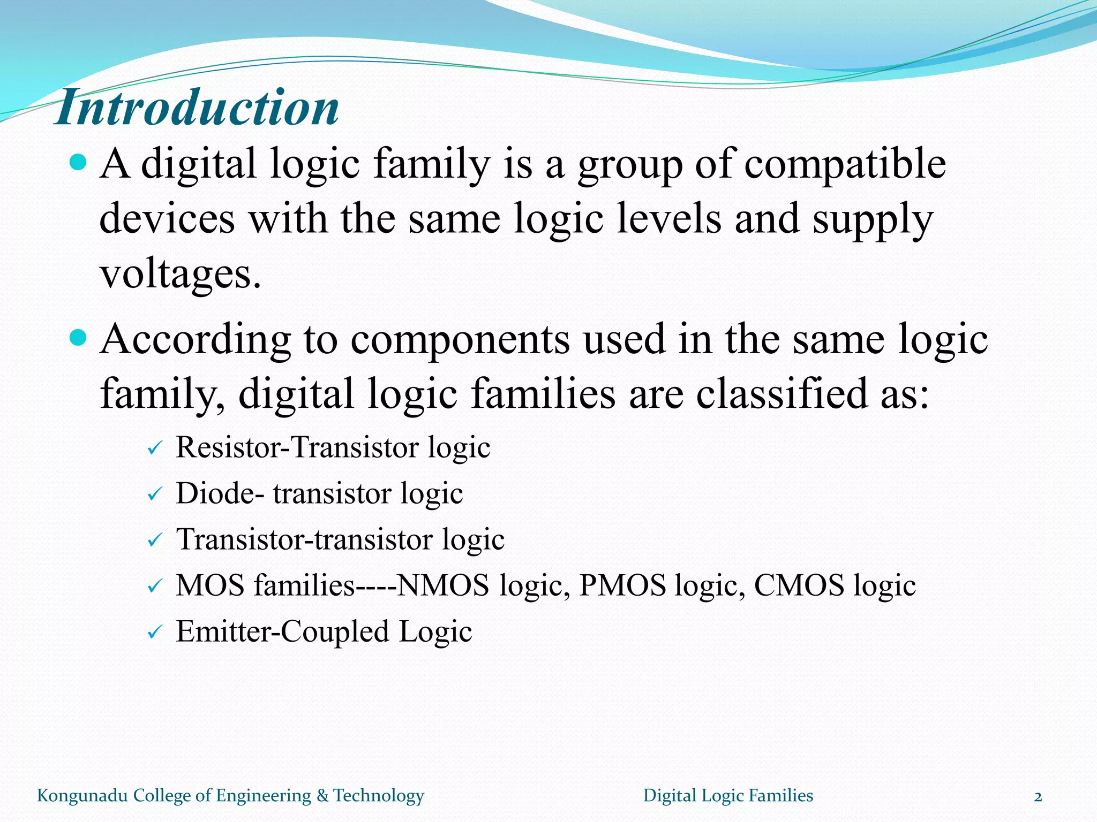

Slide 46
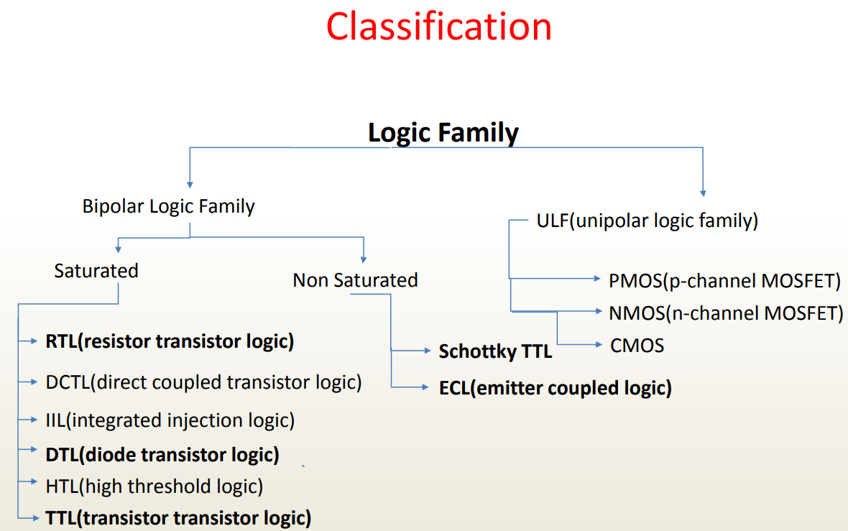

Slide 47
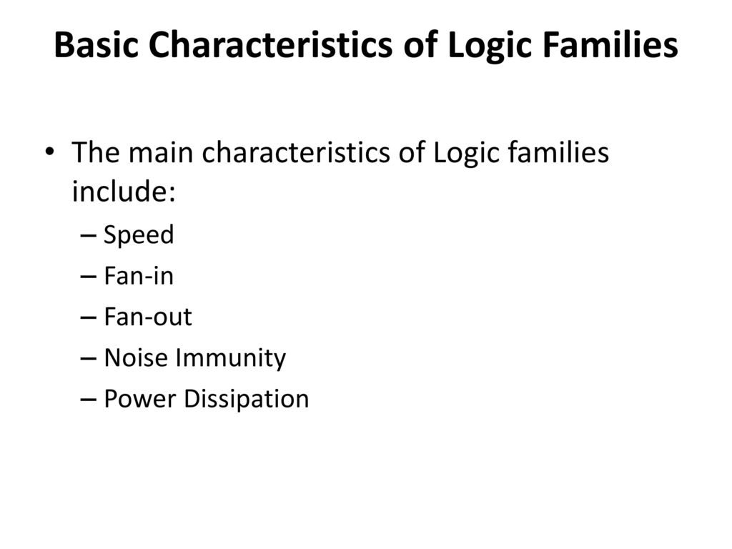

Slide 48
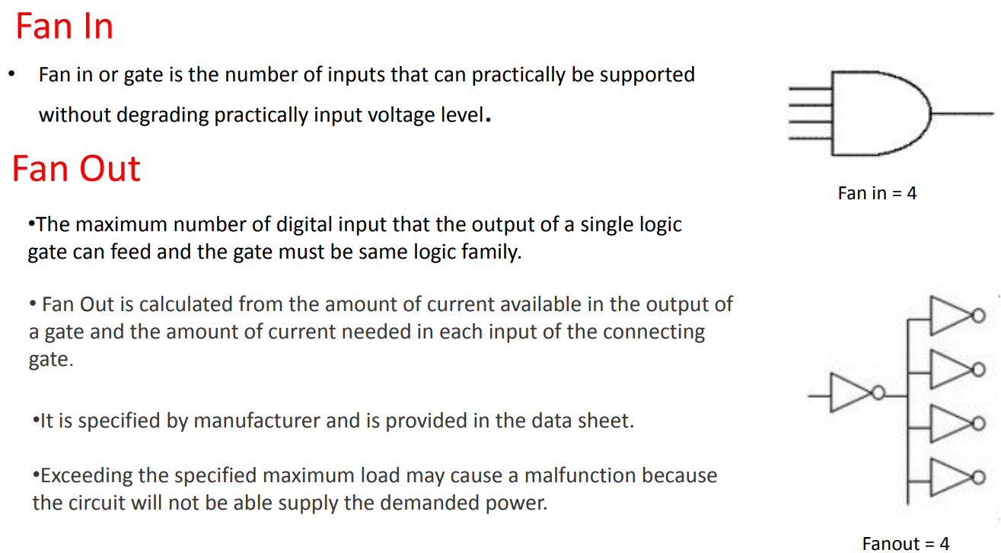

Slide 49
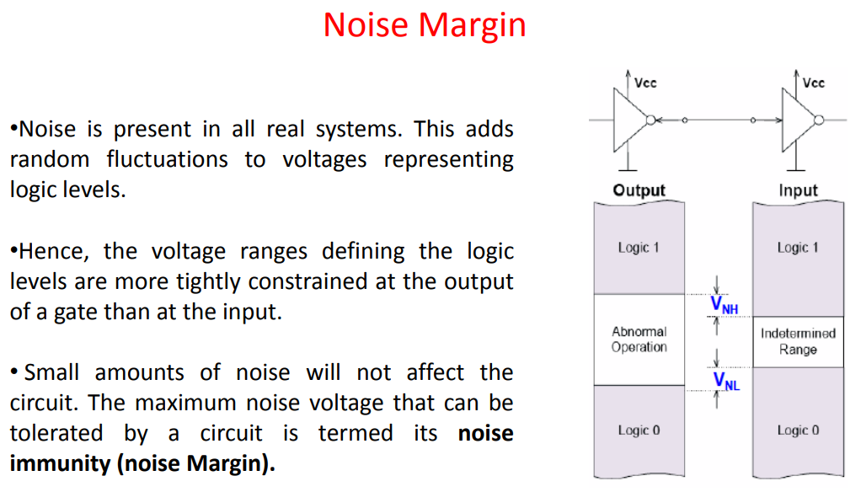

Slide 50
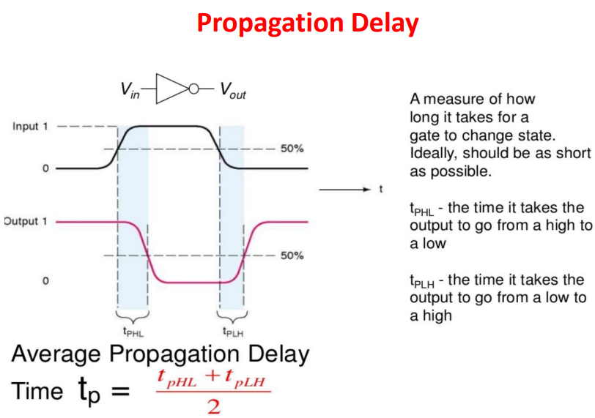

Slide 51
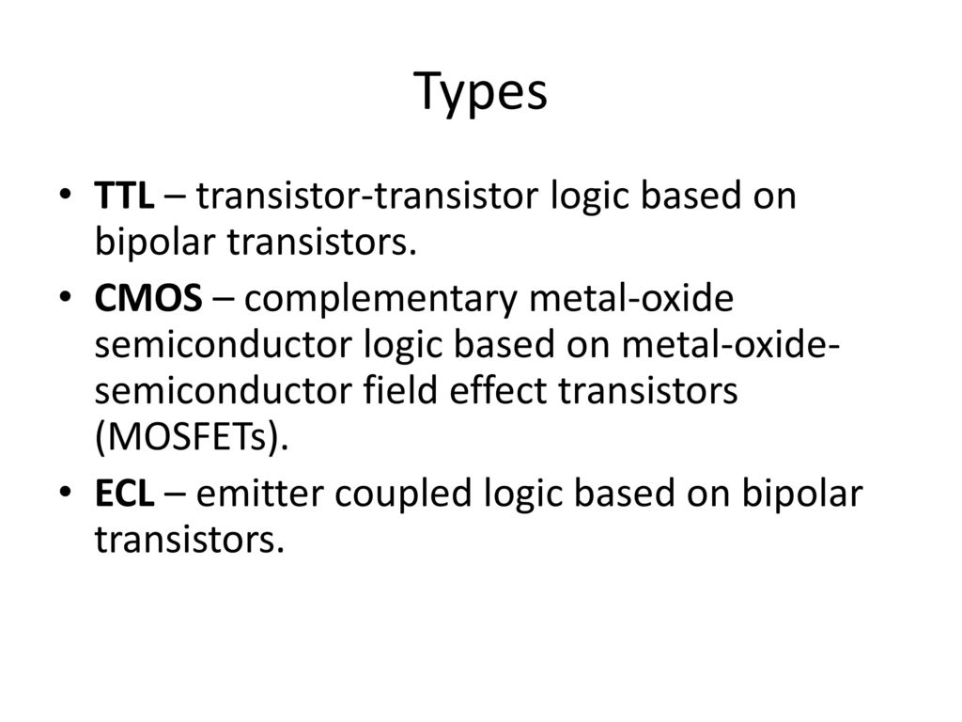

Slide 52
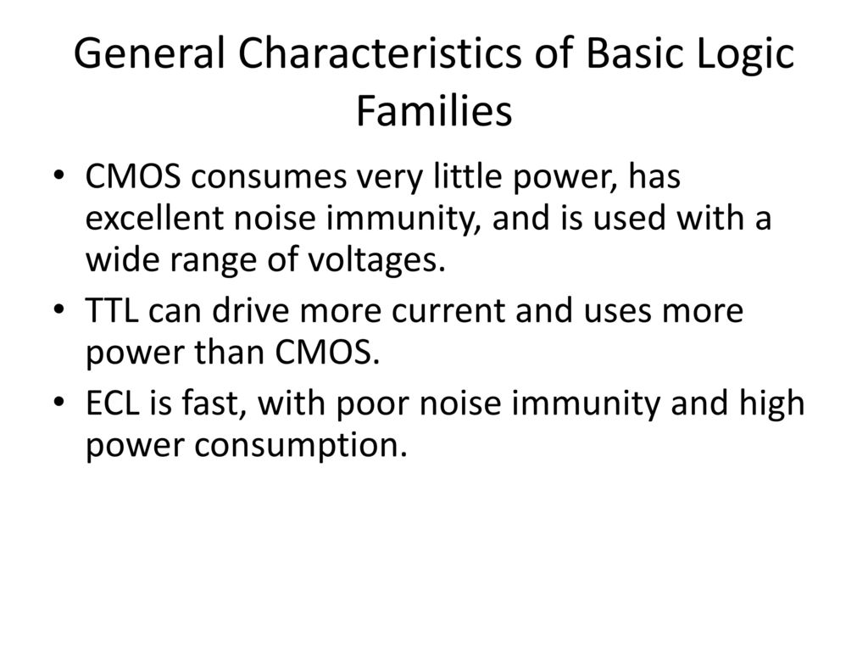

Slide 53


Slide 54


Slide 55


Slide 56


Slide 57

TTL NAND Gate with Totem Pole Output

Slide 58

TTL NAND gate Open Collector Output

Slide 59


